Slide 1
Producing a complete Linux system with a single command (and configuration file) with Yocto
Alexander Kanavin
alex@linutronix.de
alex.kanavin@gmail.com
Notes:
- distribution engineer
- splitting time between helping companies and maintaining core
- writng software sustainably, solving problems once

Slide 2
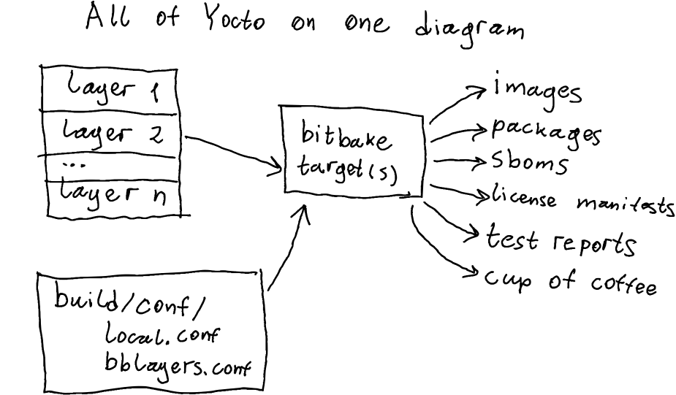
Notes:
- start by revewing what yocto does
- produces things that are needed to ship a product (or hobbyists: make a useful custom distro and image) without having vendors supplying prebuilt blobs
- bitbake is a task graph processor
- inputs are layers and build configuration
- how to set up inputs? Next slide :)

Slide 3
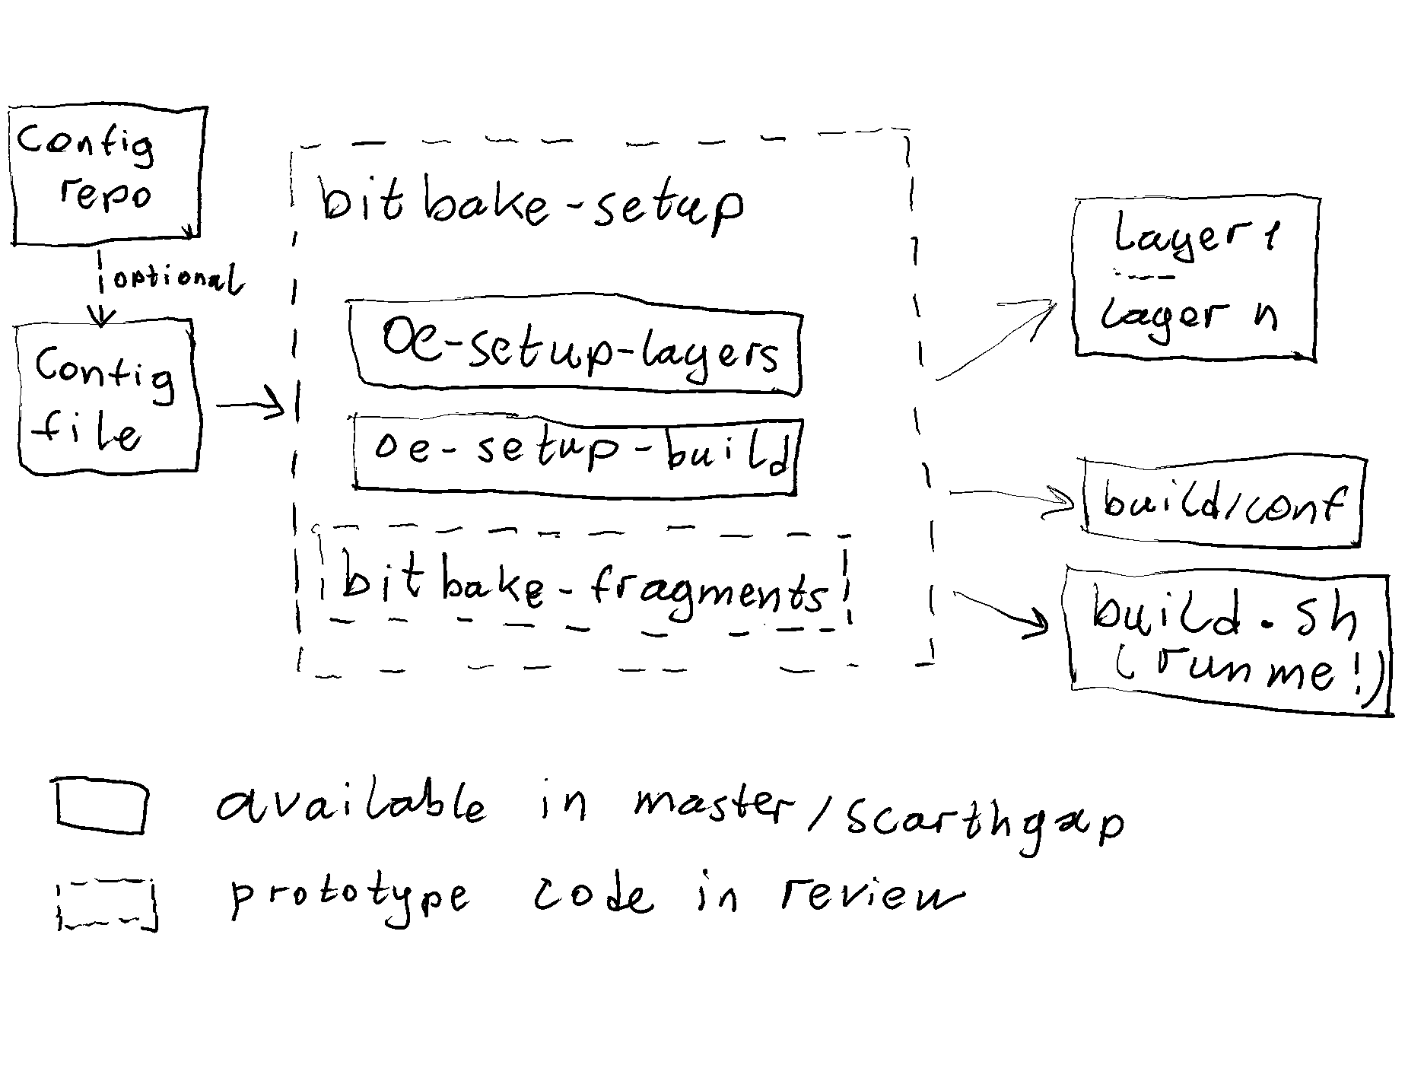
Notes:
This is to the left of previous slide: setting things up for a yocto build
Two of the four pieces are in master/scarthgap, two are in review
Bitbake-setup is an integrated tool that does everything from a single file
Setup layers
Setup build config from template
Add config fragments as specified
Directed by a config file (which is short and simple)
Can be on disk
Http uri
Or in a git repo with several other configs (then you need to list them and select one)

Slide 4
Bitbake-setup (Prototype! Subject to change!)
https://github.com/kanavin/bitbake
List
  Lists available configurations
Init
  Initializes a yocto build using a specified configuration
Status
  Checks if the configuration has been updated upstream
Update
  Updates a previously initialized configuration
Notes:
Copy of upstream bitbake repo that adds the tool
Four basic operations

Slide 5
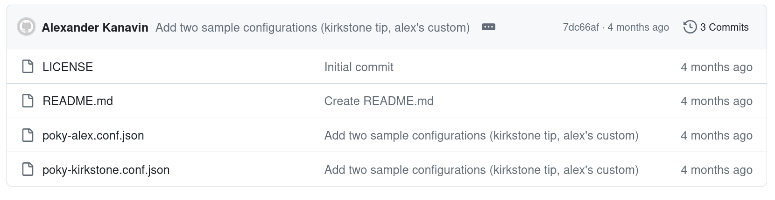
Configuration repository (also a prototype!)
https://github.com/kanavin/bitbake-setup-configurations

Slide 6
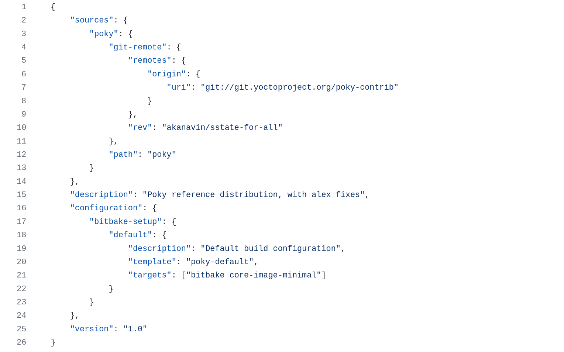
Configuration (a prototype too!)

Slide 7
Demo!
$ git clone https://github.com/kanavin/bitbake
$ bitbake/bin/bitbake-setup list
$ bitbake/bin/bitbake-setup init poky-alex
$ /home/alex/builds/poky-alex/build/build.sh
(when this completes, there will be a complete Linux system produced from source!)
$ bitbake/bin/bitbake-setup status ~/builds/poky-alex/
$ bitbake/bin/bitbake-setup update ~/builds/poky-alex/

Slide 8

LINUTRONIX GmbH
Bahnhofstr. 3 | D – 88690 Uhldingen
Phone +49 7556 25 999 0
sales@linutronix.de
www.linutronix.de
Thanks for your attention
Any questions ?
Page

